Slide 1
Agile

Slide 2
What is Agile Methodology?
An agile methodology is an iterative approach to software development. Each iteration of agile methodology takes a short time interval of 1 to 4 weeks. The agile development process is aligned to deliver the changing business requirement. It distributes the software with faster and fewer changes.
The single-phase software development takes 6 to 18 months. In single-phase development, all the requirement gathering and risks management factors are predicted initially.
The agile software development process frequently takes the feedback of workable product. The workable product is delivered within 1 to 4 weeks of iteration.

Slide 3
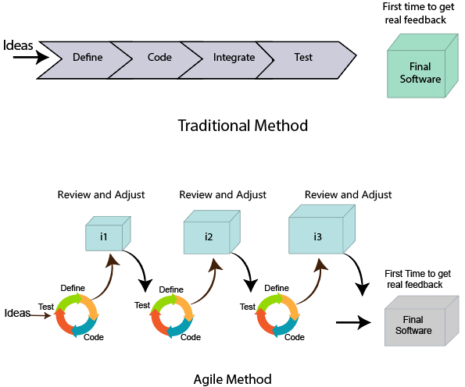
Traditional method vs Agile method

Slide 4
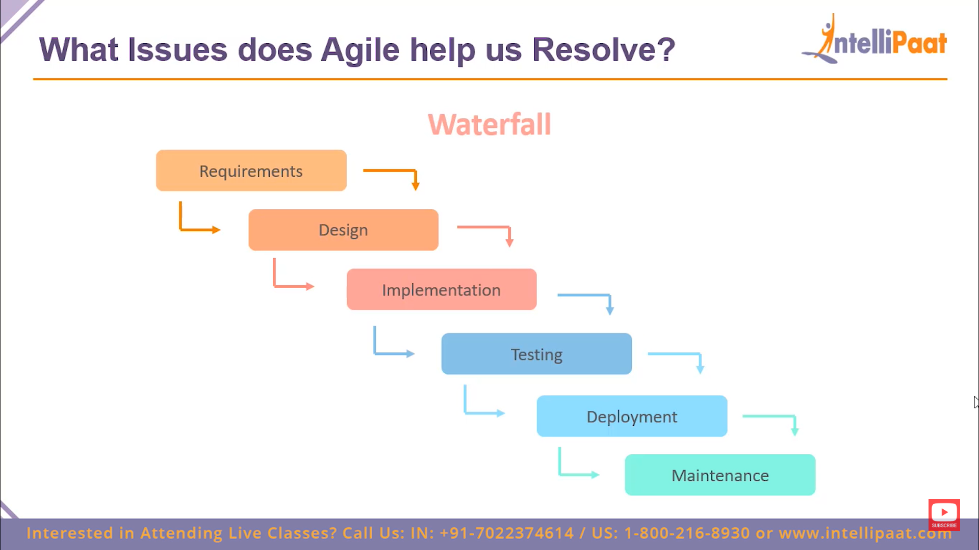
Waterfall

Slide 5
Disadvantages of Waterfall Model:
It is not an ideal model to develop a large scale project size.
It requires a clear-cut requirement at the beginning time; otherwise, it may lead to a less effective method.
It is difficult to move back to make changes in the previous phase.
The testing process starts once development is completed. Hence, it has high chances of bugs to be found later in project development. Due to this, it is costly to fix.

Slide 6
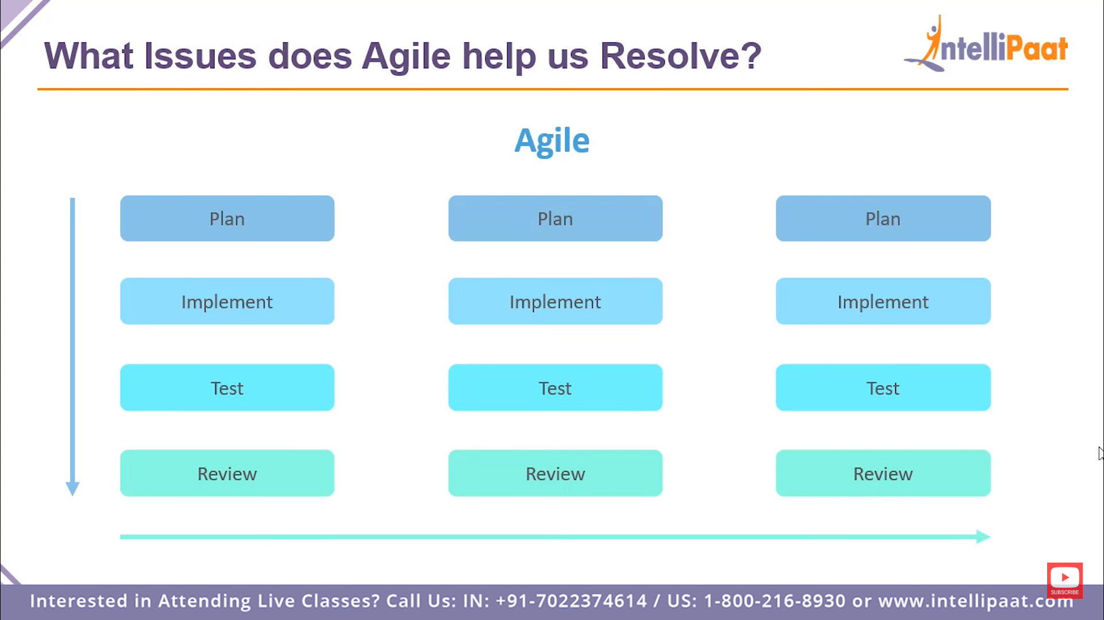
Issue Solved by Agile

Slide 7
Advantages of Agile Methodology
Customer satisfaction is rapid, continuous development and delivery of useful software.
Customer, Developer, and Product Owner interact regularly to emphasize rather than processes and tools.
Product is developed fast and frequently delivered (weeks rather than months.)
A face-to-face conversation is the best form of communication.
It continuously gave attention to technical excellence and good design.
Daily and close cooperation between business people and developers.
Regular adaptation to changing circumstances.
Even late changes in requirements are welcomed.

Slide 8
1. Scrum Master
The Scrum Master is a team leader and facility provider who helps the team member to follow agile practices, so that the team member meets their commitments and customers requirements. The scrum master plays the following responsibilities:
They enable the close co-operation between all the roles and functions.
They remove all the blocks which occur.
They safeguard the team from any disturbances.
They work with the organization to track the progress and processes of the company.
They ensure that Agile Inspect & Adapt processes are leveraged correctly which includes
Planned meetings
Daily stand-ups
Demo
Review
Retrospective meetings, and
Facilitate team meetings and decision-making process.

Slide 9
2. Product Owner
The Product Owner is one who runs the product from a business perspective. The Product Owner plays the following responsibilities:
He defines the requirements and prioritizes their values.
He sets the release date and contents.
He takes an active role in iteration and releasing planning meetings.
He ensures that the team is working on the most valued requirement.
He represents the voice of the customer.
He accepts the user stories that meet the definition of done and defined acceptance criteria.

Slide 10
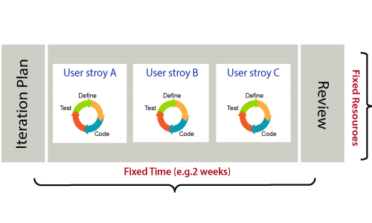
How an Agile Team plan their work?
An Agile methodology is not a specific set of ceremonies or specific development techniques. Rather, it is a group of methodologies that demonstrate a commitment to tight feedback cycles and continuous improvement. An Agile team works in iterations to deliver the customer requirement, and each iteration takes 10 to 15 days. However, the original Agile Manifesto didn't set the time period of two-week iterations or an ideal team size.
Each user requirement is a planned based and their backlog prioritization and size. The team decides, how much scope they have and how many hours available with each team to perform their planed task.

Slide 11
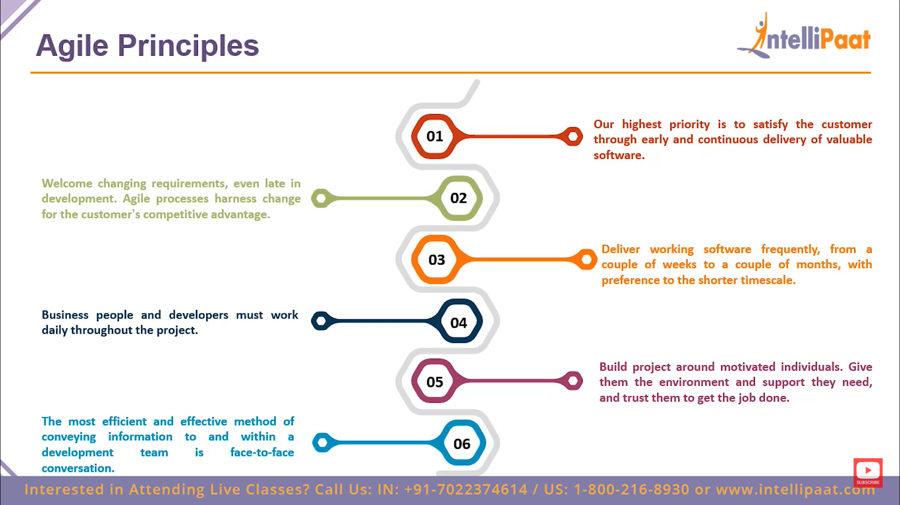

Slide 12
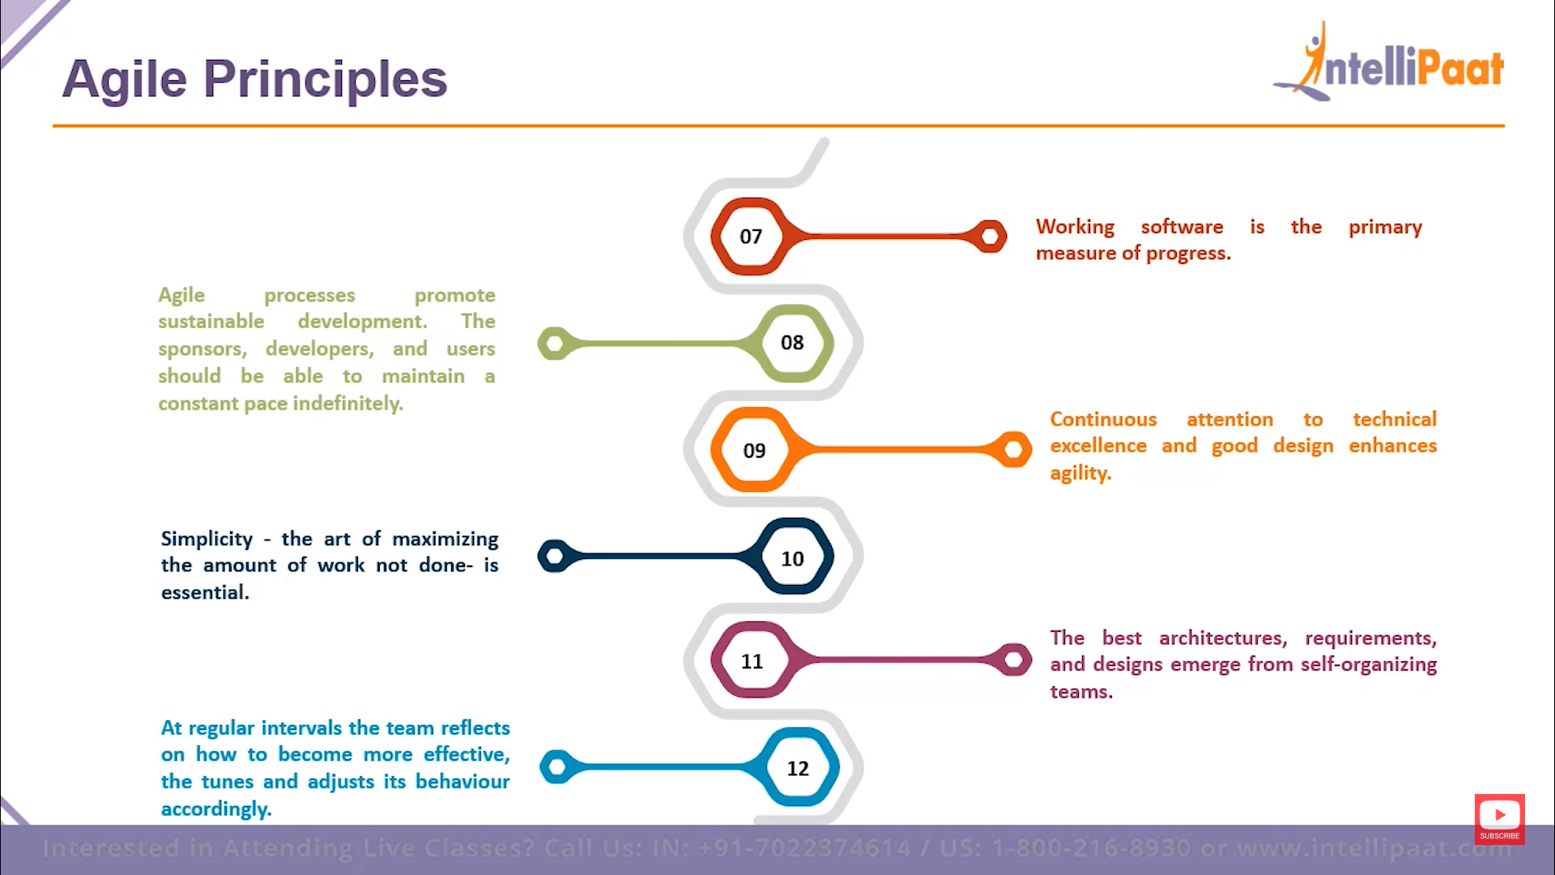

Slide 13
JIRA

Slide 14
What is JIRA?
JIRA is a software testing tool developed by the Australian Company Atlassian. It is a bug tracking tool that reports all the issues related to your software or mobile apps. The word JIRA comes from the Japanese word, i.e., "Gojira" which means Godzilla.
JIRA is based on the Agile methodology and the current version of the Jira is 6.

Slide 15
The following are the useful aspects provided by the Jira:
Projects: It is used to manage the defects very effectively.
Issue: It is used to track and manage the defects/issues.
Workflow: Processes the Issue/Defect life cycle. Suppose we have a business requirement, we create the technical design and from the technical design, we create the test cases. After creating the test cases, coding is done, and then testing is performed on the project. This design workflow is possible by using Jira.
Search: Find with ease. Suppose we have done with a project at the beginning of the December and its version is 1.0. Now, we move to version 1.1 and completed at the end of December. What we are doing is that we are adding new versions. Through Jira, we can get to know that what happened in the earlier versions, how many defects occurred in the earlier projects and the learning we achieve from the earlier projects.
Dashboards: Dashboard is a display which you see when you log in to the Jira. You can create multiple dashboards for multiple projects. You can create the personal dashboard and can add the gadgets in a dashboard so that you can keep track of the assignments and issues that you are working on.

Slide 16
JIRA Workflow
Workflow is a set of activities which are performed to track the status and the transition of an issue during the lifecycle of an issue.
Where transition represents some work in the form of link between the two statuses when an issue moves from one status to another.
Status: Status determines the impact of the work on the issue which is filed by the tester.
In Jira tool, following are the phases that occur in the workflow:
TODO state
In Progress state
Done state

Slide 17
TODO state
There are two activities performed in the TODO state:
Issue creation
When the tester finds a defect, then they log the defect in Jira tool. Once the defect is logged in a Jira tool, the unique ticket identification number is generated by a Jira tool. This process is known as issue creation.
Summary and additional details
Issue creation requires some additional information which is to be added or updated to an issue such as issue description, priority, severity, components impacted, subtasks, upload screenshots, email history, etc. After adding all the details to an issue, Jira tool assigns the status as a TODO state.

Slide 18
Progress state
There are three activities performed in the In Progress state:
Assignee
When the issue is created, then it is assigned to a person or a team. After assigning the issue to a person, then the status changes to In Progress state.
Work Review
Work on the issue is first reviewed and monitored by the issue reporter, assignee, and other project's management folks. When the developer removes an issue, then it is first unit tested by the developer, and then the code review team reviews it. During the work review activity, the status remains in the In Progress state.
Quality Analysis
After code review, the changes are verified by the quality analysis team, which includes regression testing. If the QA team finds any problem in the changes, then the issue is reassigned to the developer otherwise QA team will close the issue which states that the issue has been fixed. During the Quality Analysis, the status remains in the In Progress state.

Slide 19
Done state:
Release to production Once the product has been developed and tested, then the product is released in the market. When the product is released in the market, then the status is changed to Done state.

Slide 20
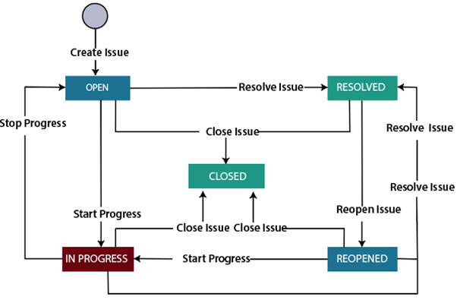
JIRA Workflow can also be referred to as a defect lifecycle. The defect lifecycle is shown below:

Slide 21
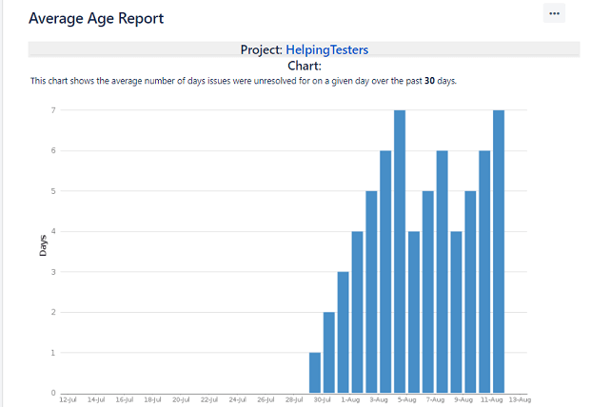
Jira Reports
Following are the reports generated by report:
Average age report
An average age report shows the average age of unresolved issues for a project or a filter. It helps you to show whether the backlog is kept up-to-date or not.
Basically, it finds the average number of days for which the issues are kept unresolved.
The Average Age report is generated that depends upon the selected project, the type of issue selected in the filter, and time is chosen (hours/days/week/months).

Slide 22
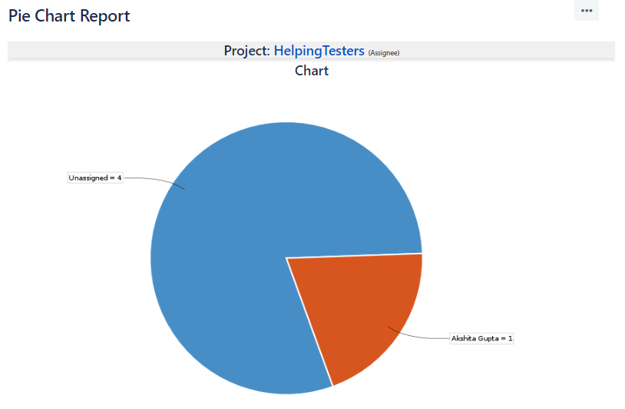
Pie chart
The pie chart displays the issues which are returned from the specified project or an issue filter. We can create an issue filter that retrieves all the issues belonging to a specific version of a particular project. The pie chart is created to group all the issues belonging to a specific statistic type, and statistic type can be Assignee, project, etc.
Suppose I choose the statistic type as Assignee.

Slide 23
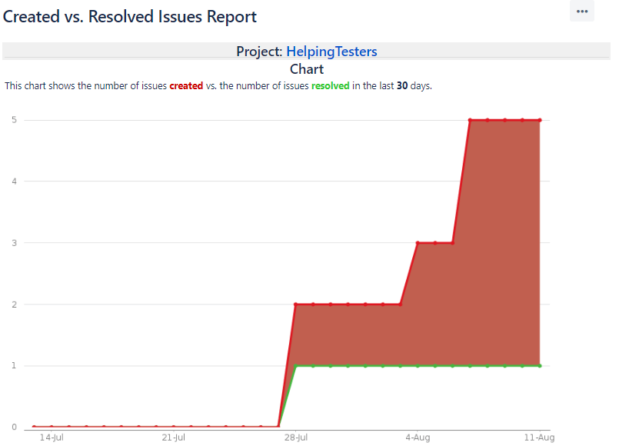
Created vs. Resolved issue
The created vs. resolved issue is a report that displays the number of issues which are created and resolved over a given period of time.
This report is created based on the project and issue filter that the user chooses and the chart can either be cumulative or not.

